Slide 1
Week 1 JOiNS
IN705 Databases 3 - 2019

Slide 2
Complex Joins
http://www.ibm.com/developerworks/data/library/techarticle/purcell/0112purcell.html
Notes:
You will have learned how to join in DB2, but there are more complex joins than the ones you learned there
First we will briefly review the need for and syntax of joins, then we will talk about how they are implemented by the system
This will help you to understand the more complex joins we will introduce today
This is a good article. It’s written for ORACLE SQL, and it would be good for you to have some idea about that

Slide 3
Complex Joins
At the top level there are mainly 3 types of joins:
INNER
OUTER
CROSS
It is worth reading the documentation of how to join on different data types.
https://docs.microsoft.com/en-us/sql/relational-databases/performance/joins?view=sql-server-2017

Slide 4
Complex Joins
In Sql Server joins syntax OUTER is optional
LEFT OUTER JOIN => LEFT JOIN
RIGHT OUTER JOIN => RIGHT JOIN
FULL OUTER JOIN => FULL JOIN
Other equivalent syntaxes
INNER JOIN => JOIN
CROSS JOIN => , ,

Slide 5
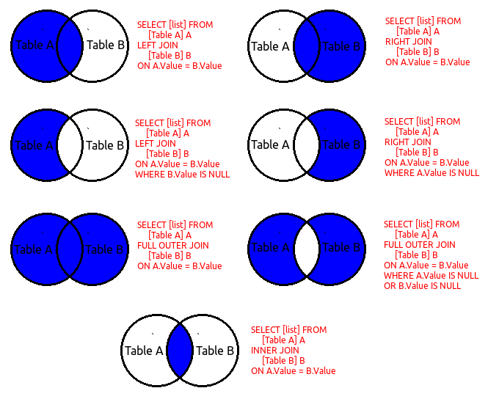
Complex Joins

Slide 6
LEFT OUTER JOIN
Returns every record of the left table
All rows that satisfy the ON condition
For any records in the left table that have no matches, fields from the right table are assigned NULL
Notes:
In an outer join, rows that do not meet the on clause conditions are included in the joined table with null-supplied values for the inner table of the outer join
The matched rows are put into the return set first
Then any records from the left table that haven’t been included are added back into the return set with NULL for all fields from the right table.
WHERE and HAVING are applied as appropriate to this set

Slide 7
RIGHT OUTER JOIN
The right table is the included table.
For unmatched records in the right table, NULL values are supplied for all fields from the left table.

Slide 8
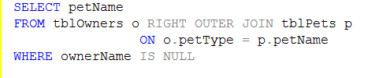

Outer Joins
Uses of Outer Joins
Will always show all records, unlike INNER JOINS which can omit instances completely if there is no match
Valuable for searches on NULL conditions
Notes:
For example, how would you find all the pets that nobody owned?
Something to note here: why not WHERE ownerName = NULL?
NULL is an undefined value, it can never be equal to anything. Two NULLs are not even equal to each other
That is why SQL must provide IS NULL

Slide 9
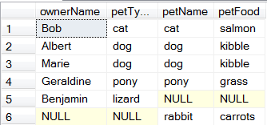
FULL OUTER JOIN
Return set includes
All matched records
All unmatched from the left table with NULL supplied for fields from the right
All unmatched from the left table with NULL supplied for fields from the left
Notes:
The full other join is actually used primarily as a derived table in more complex queries.
We will see some examples later in the term

